Slide 1




GOLDEN DAWN
HACKTOBERFEST 1.0

Slide 2






Problem statement
CookBook
Many individuals struggle with finding and preparing healthy, delicious, and diverse meals due to a lack of time, culinary expertise, or access to varied recipes.
To solve this problem we are making an user-friendly website where we can find everything about a receipe.

Slide 3

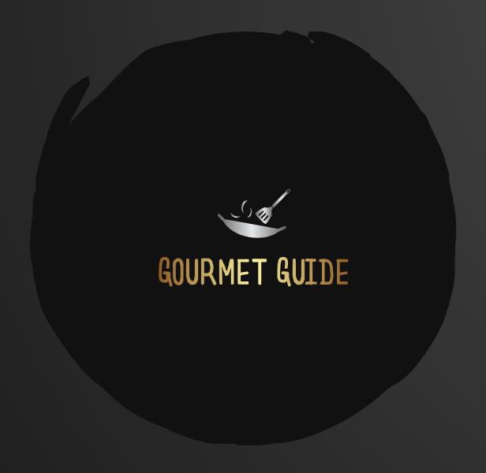

Solution
To address this problem, we propose creating a user-friendly cooking and meal planning website ”GOURMET GUIDE” that offers a wide variety of healthy and delicious recipes, suitable for all cooking skill levels. This website will also include features for ingredient based search feature, categorize by cost and preparation time and tips for efficient meal preparation, helping individuals make better dietary choices .

Slide 4


Key Features and Functionality
USER-FRIENDLY INTERFACE WITH INTUITIVE NAVIGATION.
CATEGORIZE RECIPES BY COST AND PREPARATION TIME.
INGREDIENT BASED SEARCH.

Slide 5

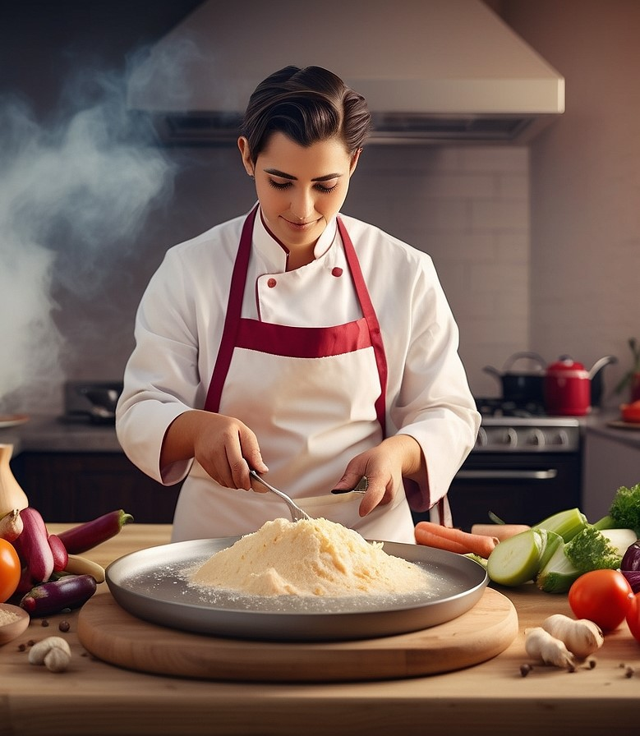
Social impact
BY OFFERING ACCESS TO WIDE VARIETY OF RECIEPES WITH AVAILABLE INGREDIENTS PEOPLE ENJOY COOKING AND EATING.
PEOPLE CAN EXPLORE DIFFERENT CULTURES WITH FOOD.
USERS CAN SAVE THEIR TIME WITH EFFECTIVE MEAL PLANNING BY COOKING GOOD RECIEPES WITH AVAILABLE INGREDIENTS.

Slide 6


Revenue Model
Freemium Model
Website Advertising
Sponsored Recipes
Premium Recipe Content

Slide 7

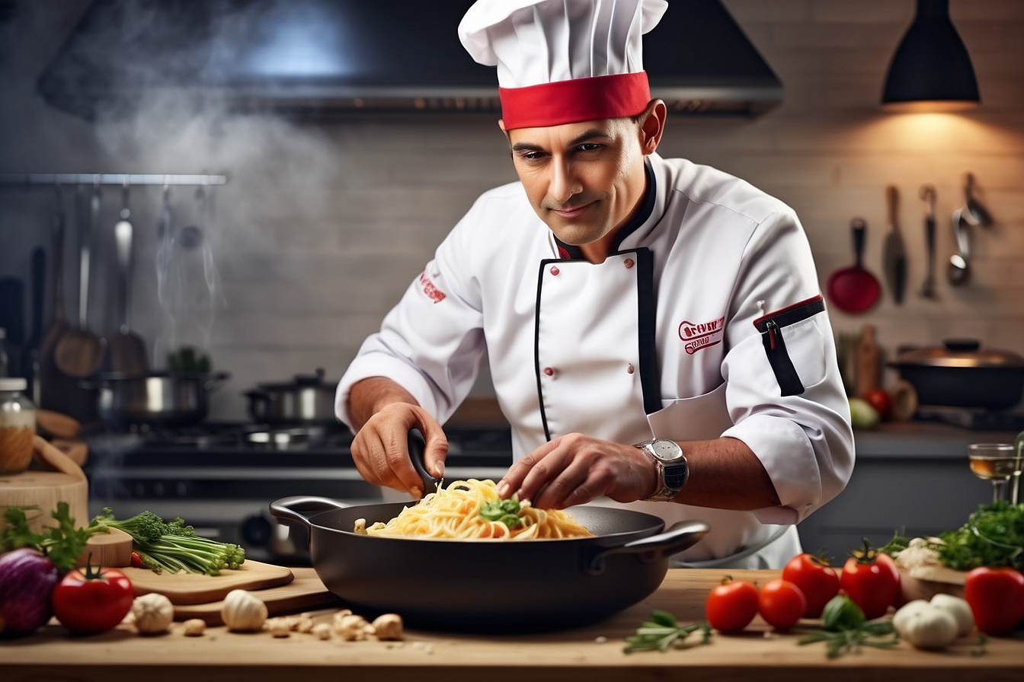

Technologies Used
OUR TEAM UTILIZED A VARIETY OF TECHNOLOGIES INCLUDING HTML, CSS PROGRAMMING LANGUAGES LIKE JAVA AND PYTHON, AS WELL AS TOOLS LIKE GITHUB..

Slide 8

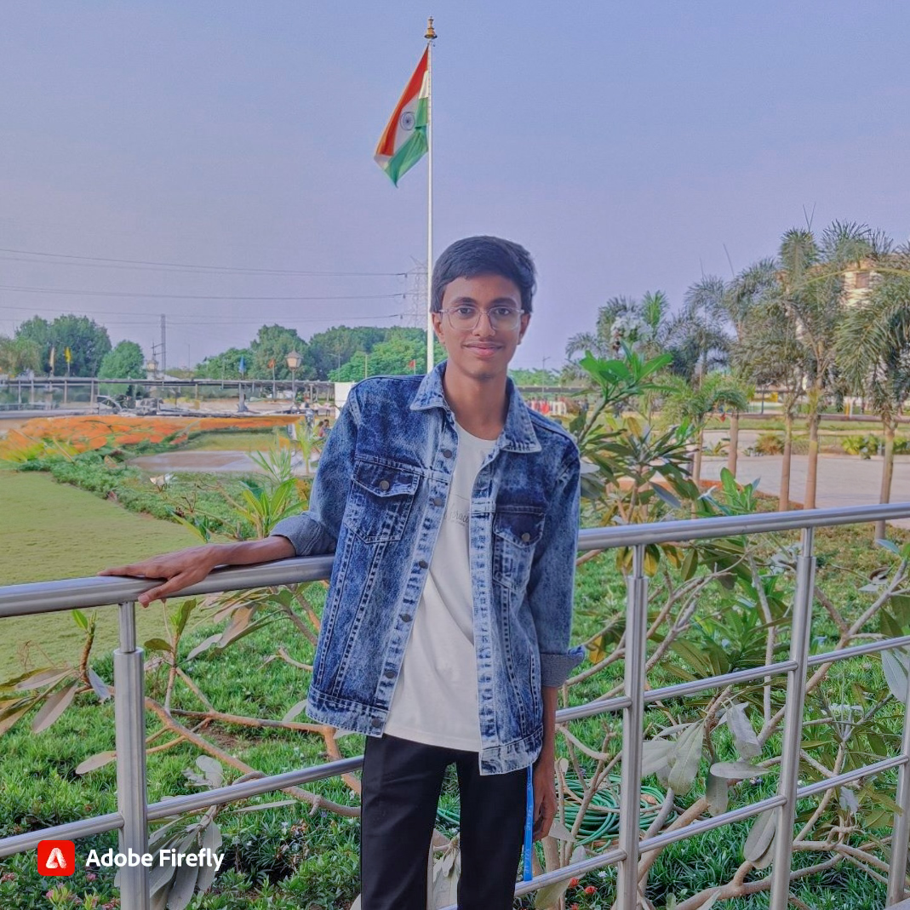


The Team
D.Shanmukha Kumar
P.Yatindra Sathvik
A.Pardhiv
STUDENT
STUDENT
STUDENT

Slide 9


Thank You
HACKTOBER FEST

